Slide 1
CSE308:COMPUTING PRACTICUM-IV
Unit 2: Scheduling Future Linux Tasks
• Scheduling a Deferred User Job • Scheduling Recurring User Jobs • Scheduling Recurring System Jobs • Managing Temporary Files
Outcome: Understand Bash scripts to schedule various tasks

Slide 2
Scheduling Future Tasks
From time to time, an administrator (or end user) wants to run a command , or set of commands ,at a set point in the future.
These scheduled commands are often called tasks or jobs.
The execution of the command or program could be one time or periodically based on a pre-determined time schedule.

Slide 3
Scheduling Future Tasks
The execution of the command or program could be one time or periodically based on a pre-determined time schedule.
One example of such an activity would be the execution of a lengthy shell program.
Recurring activities could include performing backups, trimming log files, monitoring the system, running custom scripts, and removing unwanted files from the system.

Slide 4
Scheduling one-time tasks with ‘at’
Red Hat Enterprise Linux system users can schedule future tasks with ‘at’ command.
Job scheduling and execution is taken care of by two daemons: atd and crond.
While atd manages the jobs scheduled to run one time in the future, crond is responsible for running jobs repetitively at pre-specified times.
At startup, this daemon reads schedules in files located in the /var/spool/cron and /etc/cron.d directories, and loads them in the memory for later execution.

Slide 5
cron daemon runs a job at its scheduled time only and does not entertain missed jobs.
In contrast, the atd daemon retries a missed job at the same time next day.
For any additions or changes, none of these daemon need a restart.
A new job can be scheduled by using the command
at < TIMESPEC>.
The < TIMESPEC> allows users to describe exactly when a job should be run.

Slide 6
“at” Command
Can be used to schedule a job only once and name of the service is ‘atd’
Syntax:
at HH:MM
atq – list at Jobs
atrm # remove jobs
$at 06:13
Echo “hello” > filename.txt
Save and exit (ctrl+d)
Use atq now to check the scheduled process

Slide 7
“at” Command
After execution of job use ‘atq’ and you will find no active job
Task: Create a script and make a file with that and then use ‘at’ command to run it later on.
$atrm 28 (it will delete 28 number job)
at 4:45 AM 102021
at 4 PM +4 days
at now +5 hours
at 9:00 AM tomorrow
at 11:00 AM next month
at 11:00 AM Nov 20

Slide 8
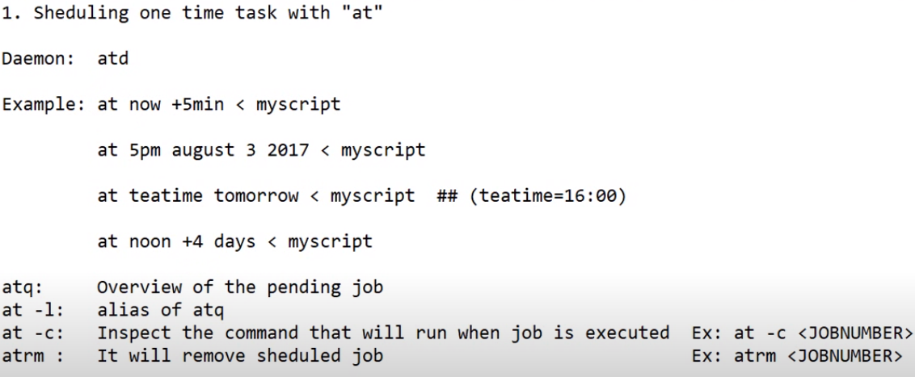

Slide 9
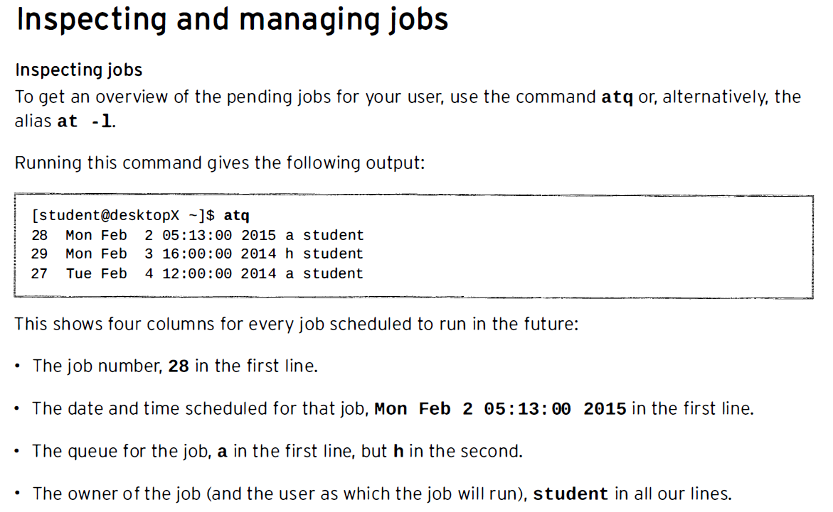

Slide 10
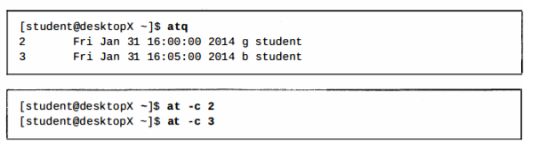

To inspect the actual commands that will run when a job is executed, use the command at -c <JOBNUMBER> .
Removing jobs
The atrm will remove a scheduled job. This is useful when a job is no longer needed.

Slide 11
Scheduling Recurring Jobs with cron
Jobs scheduled to run repeatedly are called Recurring Jobs.
Red Hat Enterprise Linux systems with the crond daemon enabled and started by default specifically for recurring jobs.
crond is controlled by multiple configuration files, one per user (edited with the crontab(1) command) ,and systemwide files.
The crond daemon is installed as part of the cronie package.

Slide 12
Why use Cronjobs?
Here are the reasons for using Cronjobs in Linux:
Helps OS to take a scheduled backup of log files or database.
Delete old log files
Archive and purge database tables
Send out any notification email such as Newsletters, Password expiration email
Regular clean-up of cached data
Crontab is an ideal option to automate Unix jobs.
It is used to automate system maintenance

Slide 13
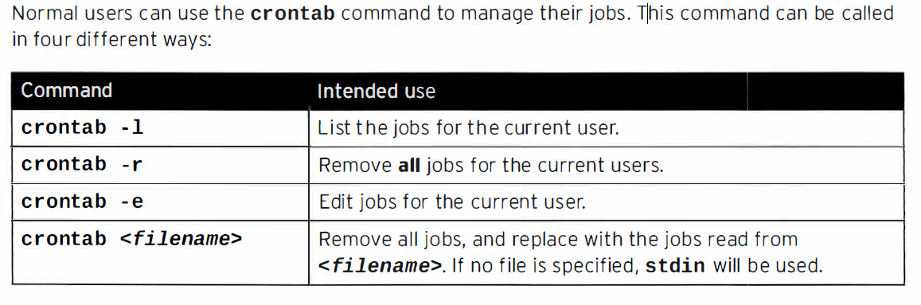
Scheduling Recurring User Jobs

Slide 14
Describing User Job Format
The crontab – e command invokes Vim/Vi by default,
The file being edited will have one job per line. Empty lines are allowed, and comments start their line with a hash symbol (#).
Environment variables can also be declared ,using the format NAME=value,

Slide 15
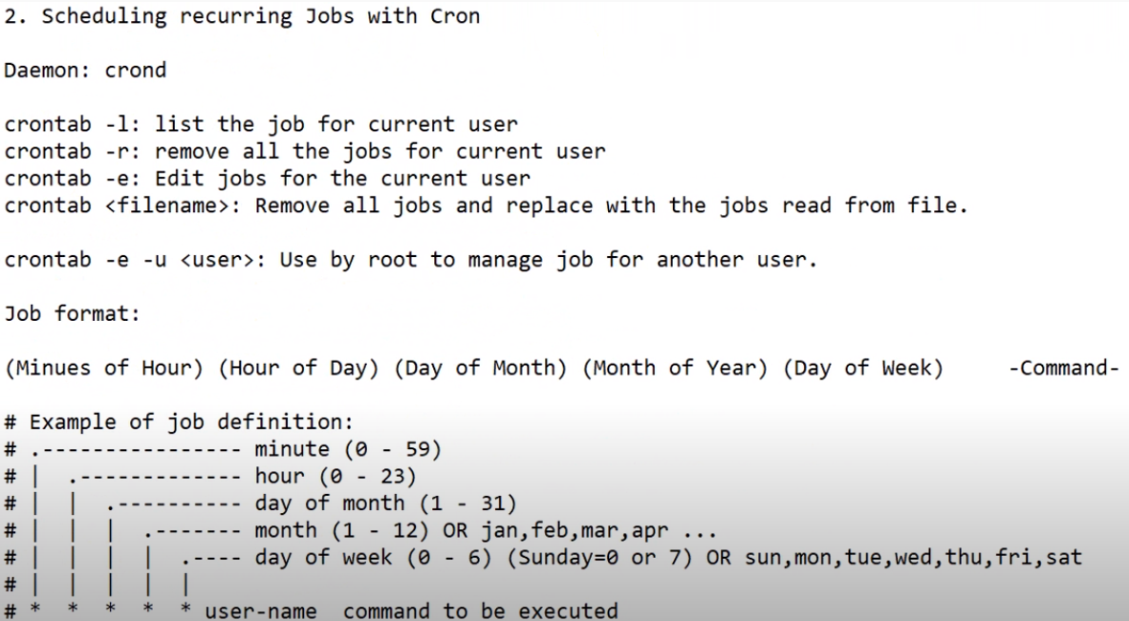

Slide 16
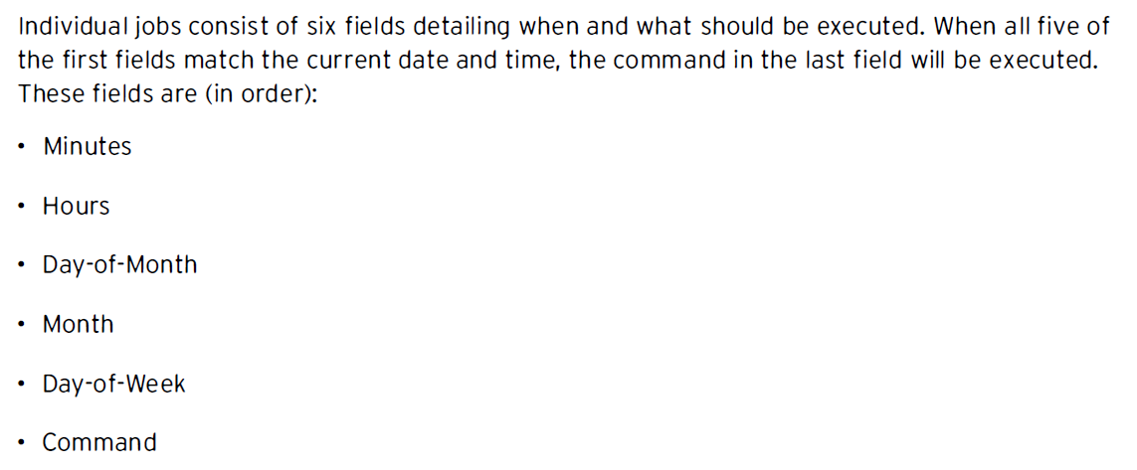
cat /etc/crontab ---- To view the fields

Slide 17
x - y for range
x, y for lists. Lists can include ranges as well , e.g .. 5, 10 - 13 , 17 in the " Minutes" column to indicate that a job should run at 5 minutes past the hour, 10 minutes past. 11minutes past. 12minutes past. 13 minutes past, and 17minutes past.
*/x to indicate an interval of x, e.g .. */7 in the minutes column will run a job exactly every seven minutes.

Slide 18
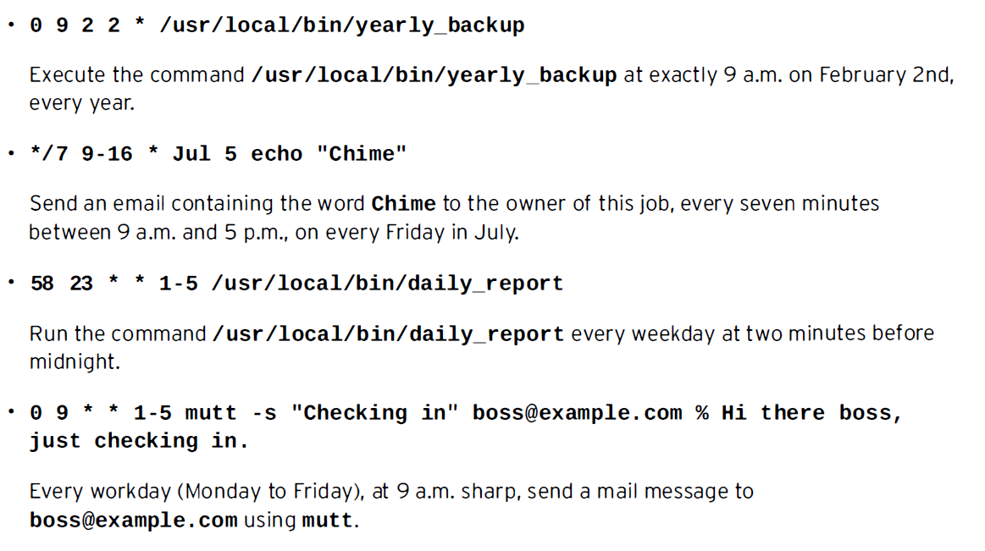

Slide 19
cat /etc/crontab ---- To view the fields
One entry per line
Comment lines begin with #
Multiple values are separated with commas.
An asterisk in a field represents all valid values means always.
man 5 crontab ---- for more details
crontab –e ----To create/edit/schedule
crontab –l ---- To list
crontab –r ---- To remove

Slide 20
Scheduling System cron Jobs
System cron jobs
Apart from user cron jobs, there are also system cron jobs.
System cron jobs are not defined using the crontab command, but are instead configured in a set of configuration files.
The main difference in these configuration files is an extra field, located between the Day-of-Week field and the Command field, specifying under which user a job should be run.

Slide 21
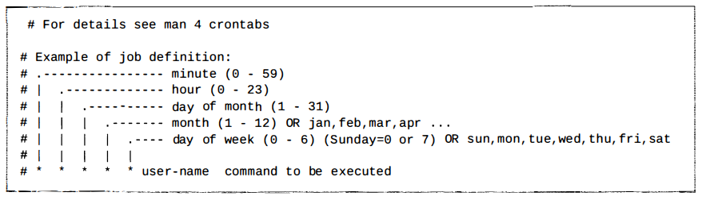
Scheduling System cron Jobs

Slide 22
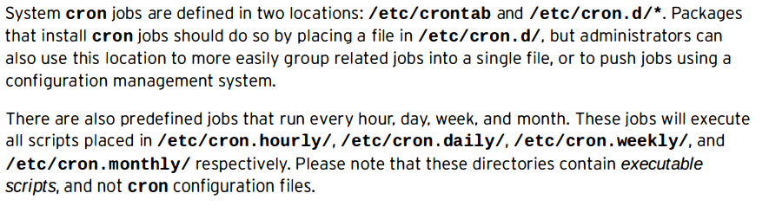
Scheduling System cron Jobs

Slide 23
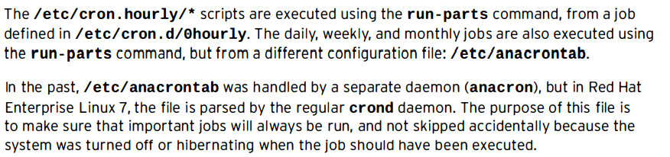
Scheduling System cron Jobs

Slide 24
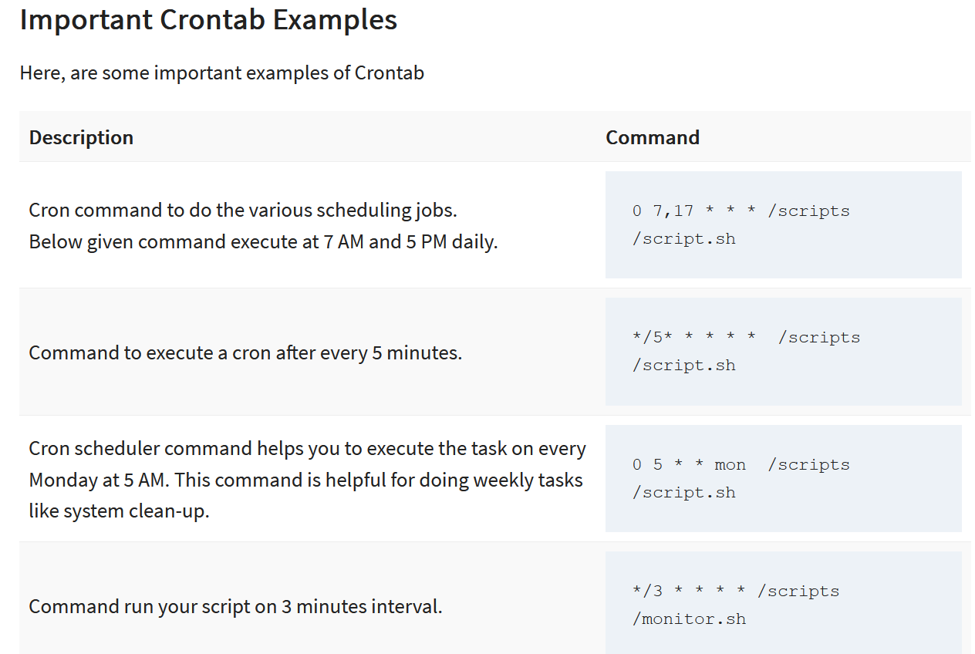
Examples cron
8. Task will be scheduled to execute on a daily basis.
@daily timestamp is similar to "0 2 * * *". It executes the task in the second minute of every day.
@daily /scripts/script.sh
9. Allows tasks to execute on an hourly.
@hourly timestamp is similar to "0 * * * *". This command executes a task in the first minute of every hour.
@hourly /scripts/script.sh

Slide 25
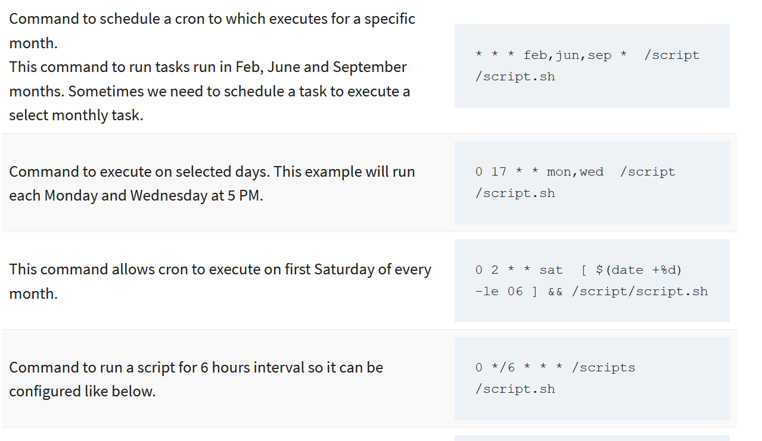
Examples cron
8. Task will be scheduled to execute on a daily basis.
@daily timestamp is similar to "0 2 * * *". It executes the task in the second minute of every day.
@daily /scripts/script.sh
9. Allows tasks to execute on an hourly.
@hourly timestamp is similar to "0 * * * *". This command executes a task in the first minute of every hour.
@hourly /scripts/script.sh

Slide 26
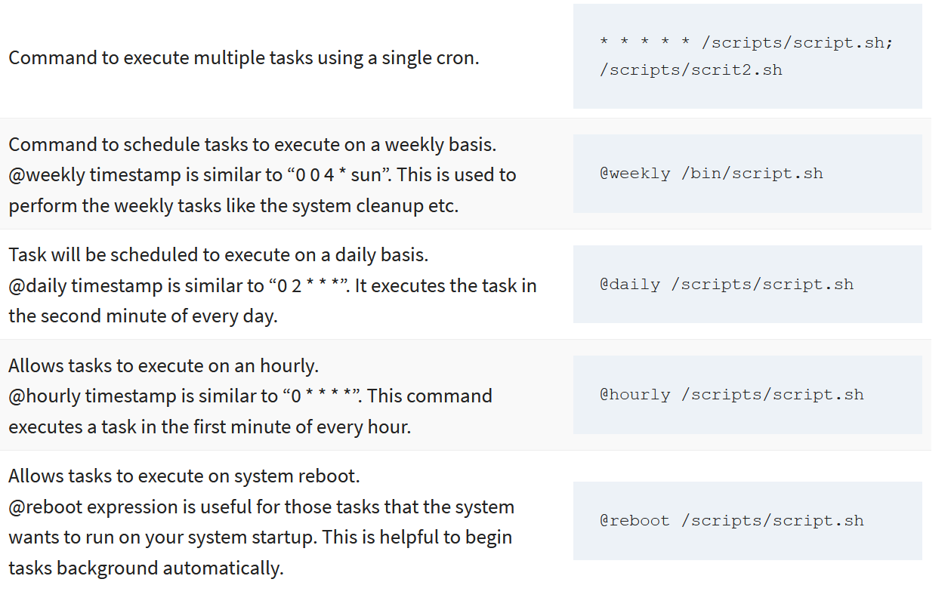
Examples cron
8. Task will be scheduled to execute on a daily basis.
@daily timestamp is similar to "0 2 * * *". It executes the task in the second minute of every day.
@daily /scripts/script.sh
9. Allows tasks to execute on an hourly.
@hourly timestamp is similar to "0 * * * *". This command executes a task in the first minute of every hour.
@hourly /scripts/script.sh

Slide 27
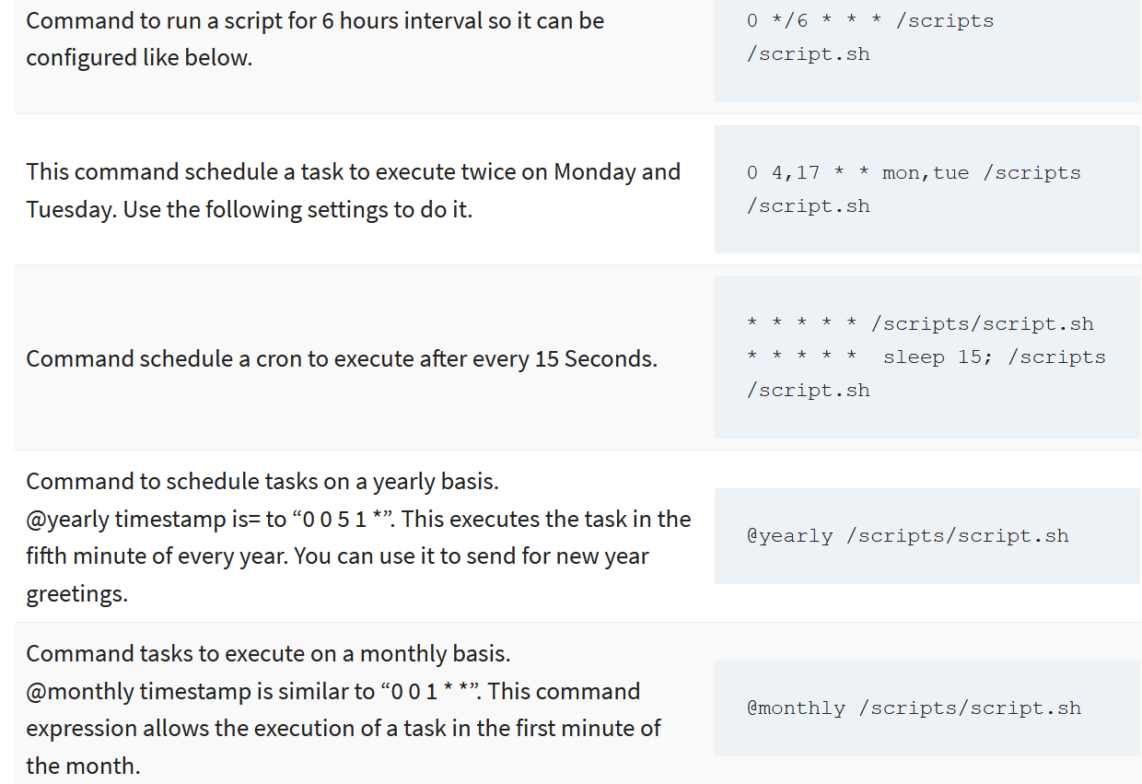
Examples cron
8. Task will be scheduled to execute on a daily basis.
@daily timestamp is similar to "0 2 * * *". It executes the task in the second minute of every day.
@daily /scripts/script.sh
9. Allows tasks to execute on an hourly.
@hourly timestamp is similar to "0 * * * *". This command executes a task in the first minute of every hour.
@hourly /scripts/script.sh

Slide 28
Managing Temporary Files
Manage temporary files using systemd-tmpfiles
In Red Hat Enterprise Linux 7 systemd provides a more structured, and configurable, method to manage temporary directories and files: systemd-tmpfiles.
When systemd starts a system, one of the first service units launched is systemd­tmpfiles-setup.
This service runs the command systemd-tmpfiles --create --remove.

Slide 29
In multitasking computer operating systems, a daemon is a computer program that runs as a background process, rather than being under the direct control of an interactive user. Traditionally, the process names of a daemon end with the letter d, for clarification that the process is in fact a daemon, and for differentiation between a daemon and a normal computer program.
For example
syslogd is a daemon that implements system logging facility
sshd is a daemon that serves incoming SSH connections.

Slide 30
Managing Temporary Files
Regular cleaning
To make sure that long-running systems do not fill up their disks with stale data, there is also systemd timer unit that calls systemd-tmpfiles -- clean on a regular interval.

Slide 31
Managing Temporary Files
The format of the configuration files for systemd-tmpfiles is
The basic syntax consists of seven columns: Type, Path, Mode, UID, GID, Age, and Argument.
Type:
refers to the action that systemd-tmpfiles should take;
for example, d to create a directory if it does not yet exist,
or Z to recursively restore SELinux contexts and file permissions and ownership

Slide 32
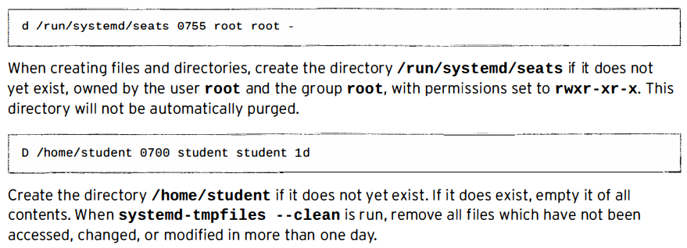
Managing Temporary Files

Slide 33
Where are user crontab files stored?
A. /etc/crontab
B. /var/spool
C. /var/spool/cron
D. ~/.cron
Notes:
C

Slide 34
Which option on the cron command is used to display entries in the current crontab?
A. -e
B. -r
C. -l
D. -s
Notes:
C

Slide 35
Which of the following is not a recommended way to specify jobs that should be executed with cron?
A.Modify /etc/crontab.
B.Put the jobs in separate scripts in /etc/cron.d.
C.Use crontab -e to create user specific cron jobs.
D.Put scripts in /etc/cron.{hourly|daily|weekly|monthly} for automatic execution.
Notes:
A

Slide 36
Which command enables you to see current at jobs scheduled for execution?
A.atrm
B.atls
C.atq
D.at
Notes:
C

